Slide 1
WAVECON ANALYSIS
Data ANALYSIS

Slide 2
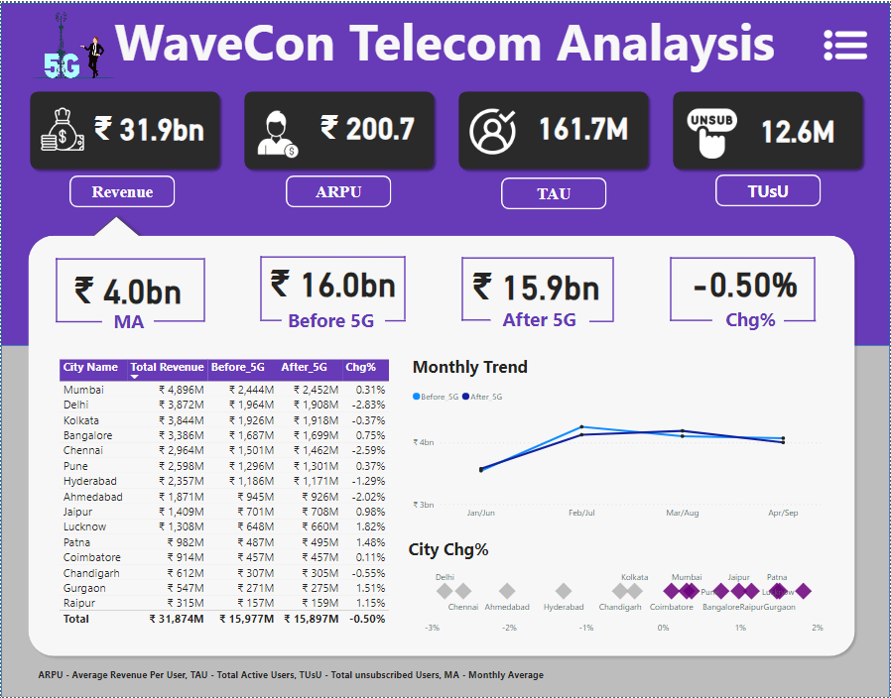

Slide 3
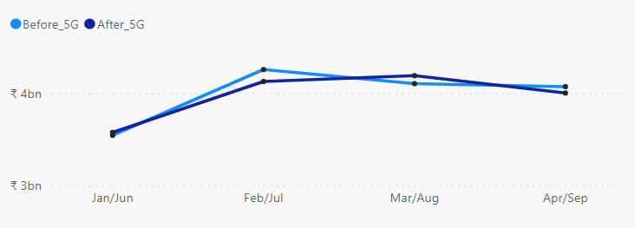
What is the impact of the 5G launch on our revenue?
Data ANALYSIS
Before the launch of 5G the company was generating a revenue of about 16 Billion.
After the launch of 5G the company is generating the revenue of about 15.9 Billion.
This indicates that there is almost 0.50% decline in the revenue generation after the launch of 5g
Revenue Generation By Month

Slide 4
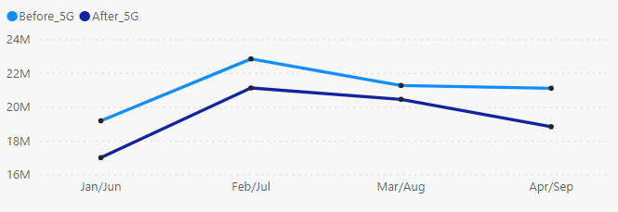
Which KPI is underperforming after the 5G launch?
Data ANALYSIS
After the launch of 5G there are 2 KPIs who are under performing.
Revenue
Revenue Generation is Dropped by 0.5% with almost decline of 0.1 Billion
Total Active User
Total Active Users are Dropped by 8.28% with almost decline of 7 Million Users
Revenue Generation By Month
Total Active Users By Month

Slide 5
After the 5G launch, which plans are performing well in terms of revenue? Which plans are not performing well?
Data ANALYSIS
Plans Performing Well
The only plan which is performing well after 5G launch is Smart Recharge Plan (2GB/Day Combo for 3 months) i.e. Plan 1.
Plan-1 is generating revenue of 2.4bn after launch of 5G where as it was generating 1.8bn before the launch of 5G.
This shows that after launch of 5G plan a has 33.33% growth in terms of revenue.

Slide 6
After the 5G launch, which plans are Not performing well in terms of revenue?
Plans Not Performing Well
Mini Data Saver Pack (Plan-4) with decline of 20.3% in terms of revenue generation.
Rs. 99 Full Talk time Combo Pack (Plan-5) with decline of 34.8% in terms of revenue generation.
Xstream Mobile Data Pack (Plan-6) with decline of 33.9% in terms of revenue generation.
25 GB Combo 3G/4G Data Pack (Plan-7) with decline of 73.3% in terms of revenue generation.

Slide 7
Is there any plan affected largely by the 5G launch? Should we continue or discontinue that plan?
Data ANALYSIS
25 GB Combo 3G/4G Data Plan (Plan-7)
Plan 7 is the plan which is the most under performing plan after the launch of 5G as it’s revenue generation is dropped by 73.3%.
Before the launch of 5G, revenue generated by this plan was 582.4 Million.
After the launch of 5G, the plan is generating only 155.6 Million revenue.
The total revenue generated by this plan is about 738 Million which is almost 2.31% of the total revenue generated by the company.
The company should discontinue this plan as this plan is not generating as much as revenue as it was generating before 5G launch.

Slide 8
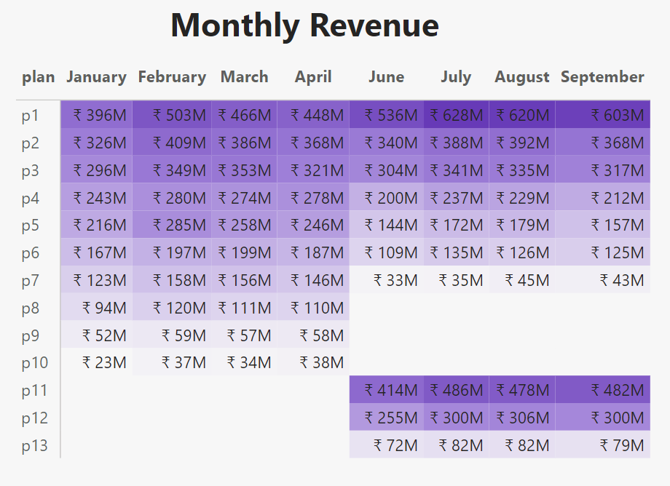
Is there any plan that is discontinued after the 5G launch? What is the reason for it?
Data ANALYSIS
Plan-8 : Daily Saviour
Plan-9 : Combo ToupUp
Plan-10 : Big Combo Plan
These 3 plans were Discontinued after launch of 5G as they were not generating enough revenue for the company before the launch of 5G and instead of them some new plans were launched which were more suitable.

Slide 9
THANKS!
Data ANALYSIS
Do you have any questions?
Kanojia122.hiren@gmail.com
+91 7405726775
Please keep this slide for attribution

